Slide 1
IAF Gender Balance Working Group presentation
Tokyo
2024 October 1st

Slide 2
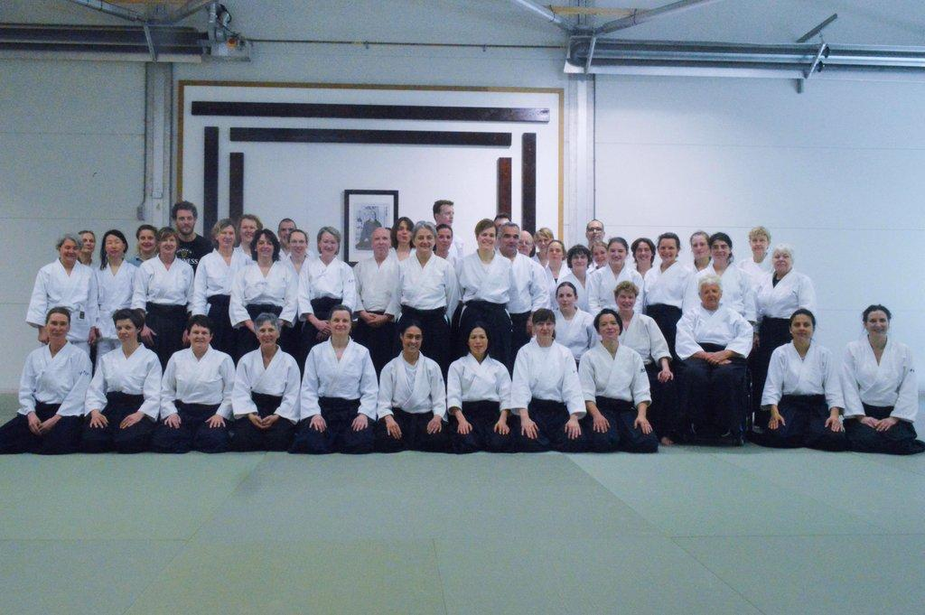
Takasaki declaration (2016) as the start
“The theme for the 12th IAF congress was the promotion of gender equality in aikido. Through classes taught by senior female instructors as well as two gender forums to explore issues of gender equality in martial arts, we have started to address this important issue for the future of aikido. We are committed to continue this journey in the future.”
第１２回国際合気道大会のテーマは合気道における男女平等を奨励 することでした。講習会の指導陣には女性の高段者が加わり、 二つのジェンダーフォーラムでは武道における男女平等に関わる諸 問題を探索する等、 将来の合気道にとって重要であるこのテーマについて取り組み始め ました。私たちは今後この探求の旅を続けることに専念します。
1st Gender Day event in the Netherlands 2017

Slide 3
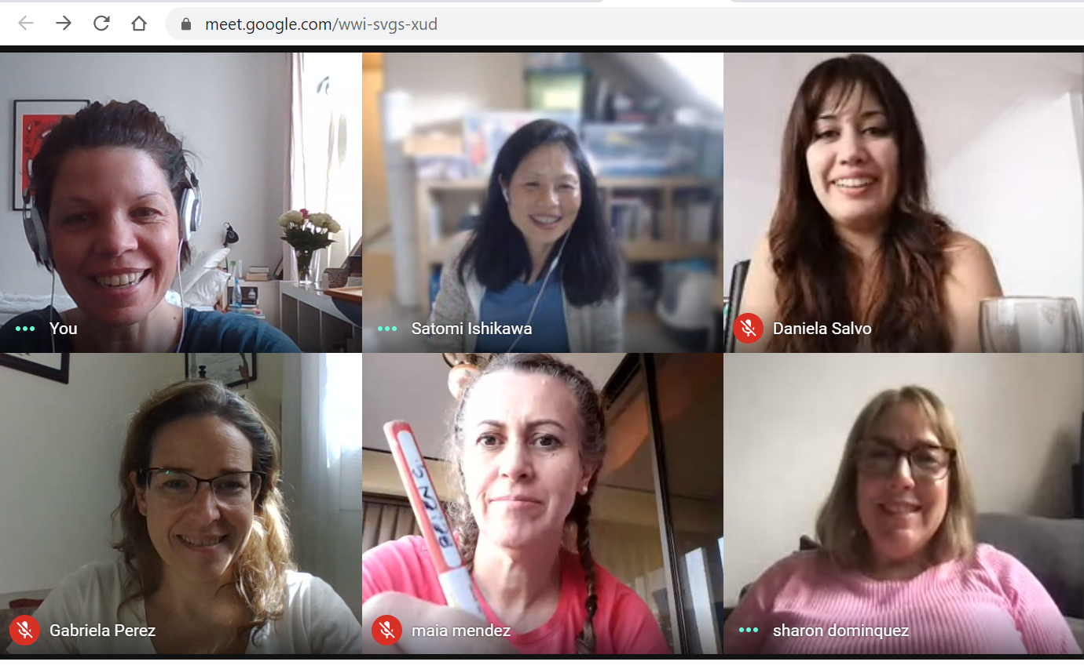
Our Story
The IAF Gender Balance Working Group started in 2016, right after the 12th IAF Congress in Takasaki. As one of the 8 working groups of the IAF, the GBWG has been carrying out modest, yet steady activities for the last 8 years, including throughout the period of the pandemic.
As a working group, we promote the idea that gender balance is a sign of health and longevity in the growth of aikido. Raising awareness towards improved gender balance has been supported in many ways by all groups.
About 30 delegates and observers from all over the world
ULA-IAF GBWG as sub-circle
Bimonthly online meetings
International Women's Day campaigns
Planning and promoting physical & online events
Online meeting in December 2023, delegates from USA, Netherlands, Slovenia, Chile and Argentina

Slide 4
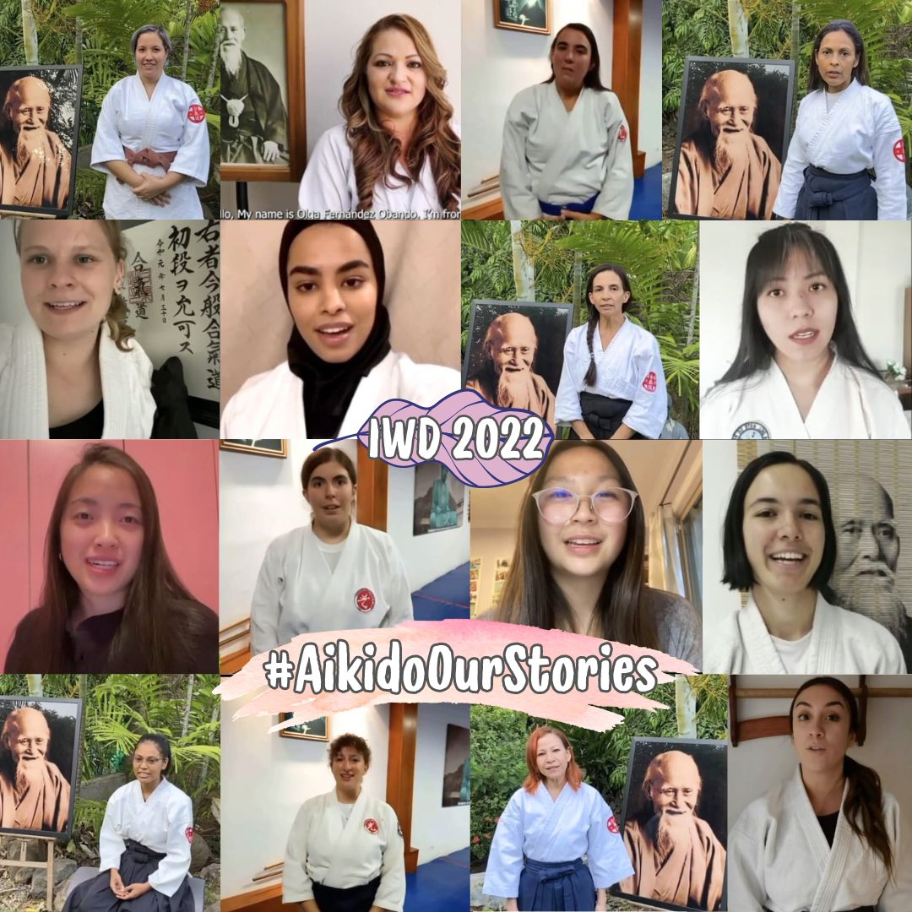
Our Mission: Current standpoint and future
While we have no actuable statistics to gauge our progress, many of us are aware that the presence of women in our art has definitely increased.
Thus, this is the perfect moment for us to further discuss women in leadership, to raise awareness of the roles of women at all levels; from chief instructors, board members and instructors who are also involved in the decision making of individual dojos as well as national and international federations.
During the 14th IAF Summit, we are hosting the gender forum Towards a Better Gender Balance: a Vision for the Future. We would like to use this time to identify different strategies and visions per region/culture, as well as sharing with us common practices in the global Aikido community to foster the inclusion of women in all aspects of aikido.
International Women’s Day campaign 2022 AikidoOurStories

Slide 5
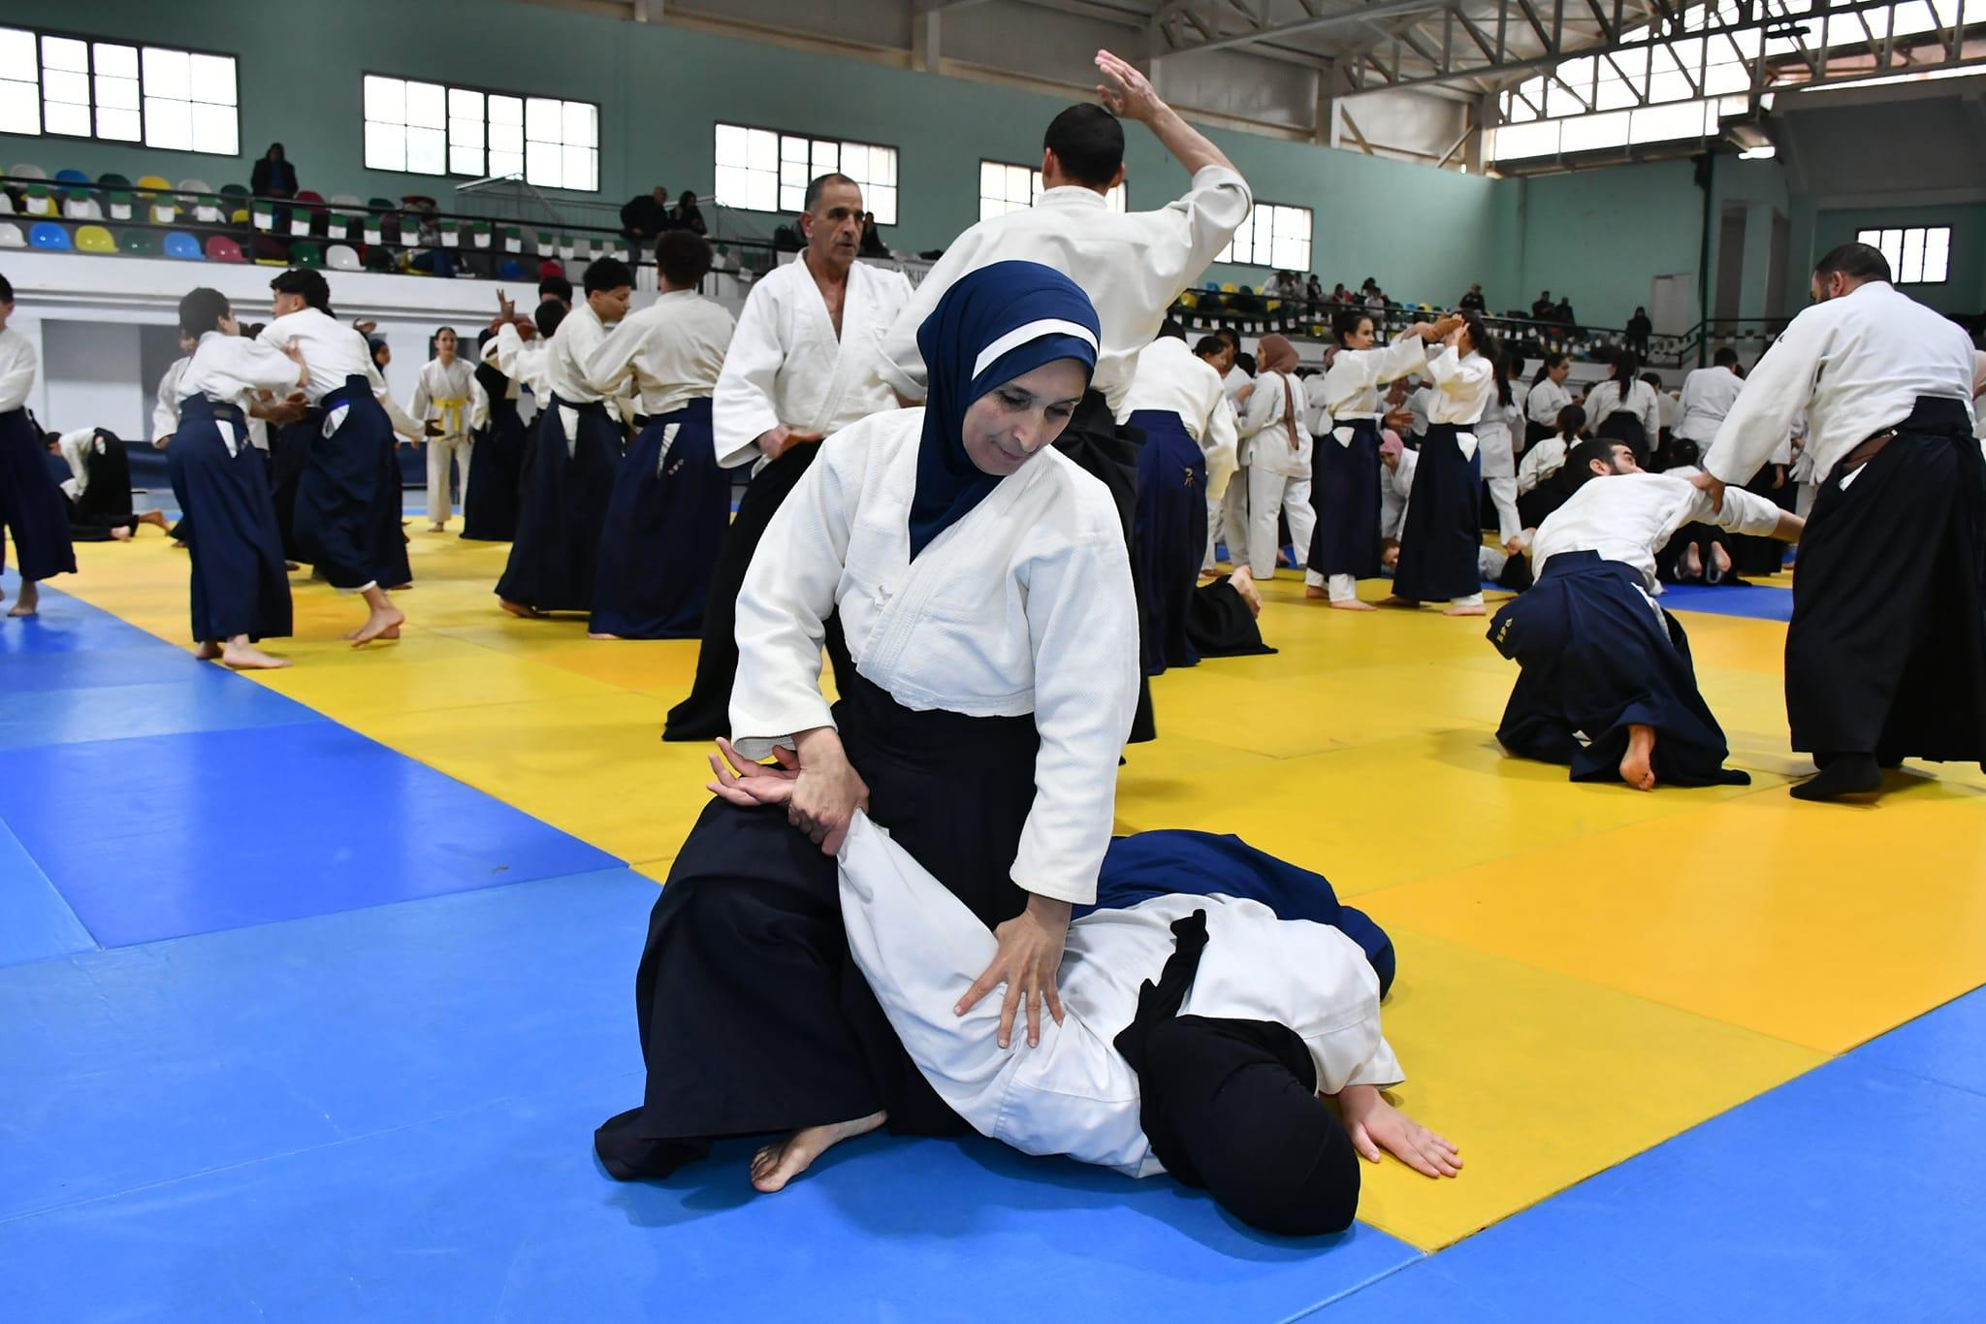
Our Actions: List of activities 2016-2024
Physical Events and Projects (co-organised with the members)
Gender Event ULA IAF, Lima 2024
Guardian Girls International in Columbia, Peru and Japan, 2024
International Women’s Day seminar in Algeria 2023/2024
Gender Event ULA IAF, Buenos Aires 2023
Erasmus Project GendAi 2021 / 2022
Female Instructor Education in Saudi Arabia 2021
Gender Day 2018/ 2019, 2022/ 2024, Slovenia
Gender Day 2017/ 2018, The Netherlands
International Female Instructor seminar in Argentina 2016-2019
International Female Instructor seminar in Chile 2019
International Women’s Day Seminar in Algeria 2024

Slide 6
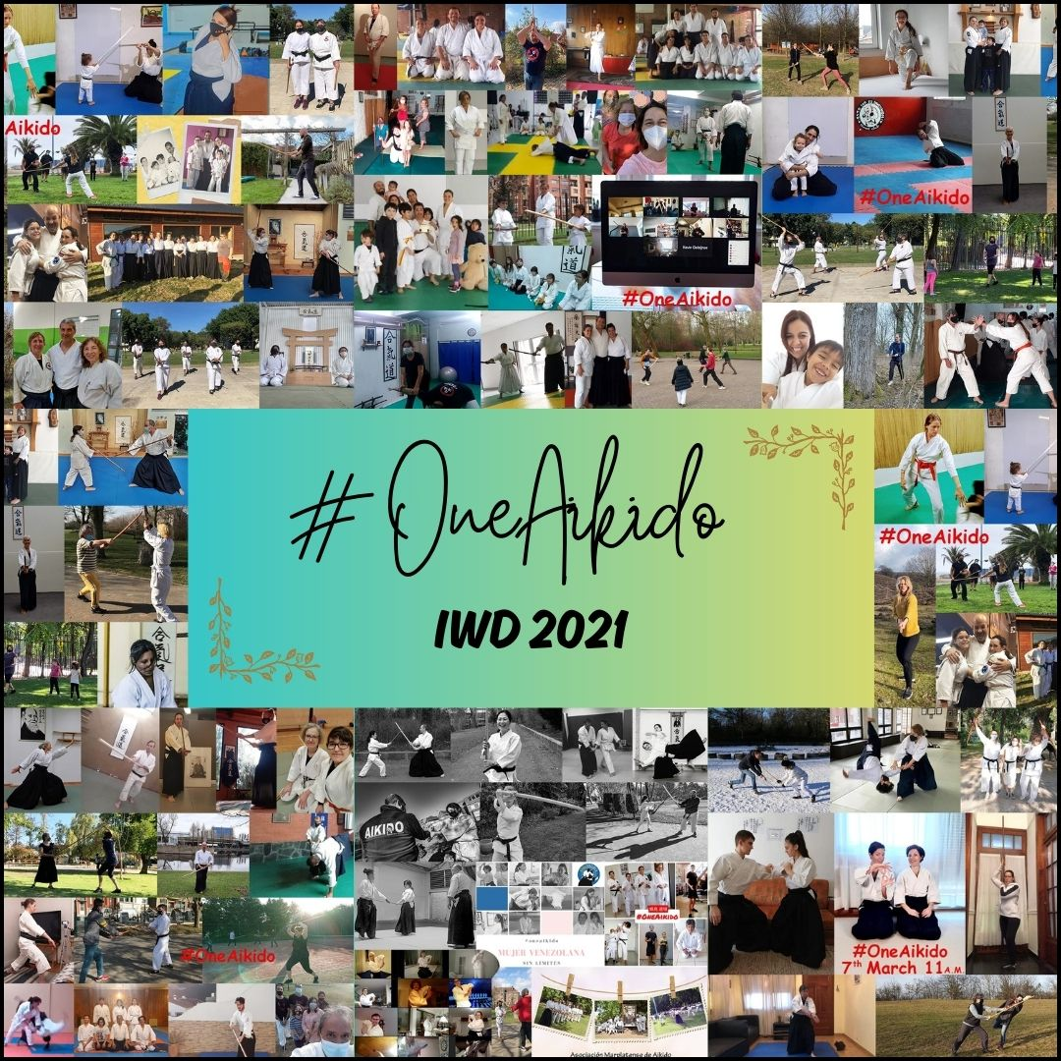
Online Projects and Campaigns
Passingjoy - Promotion via TikTok 2023
Aikido OurStories - Instagram project 2022
OneAikido - Facebook campaign 2021
AikidoWomen - Facebook campaign 2017-2018
You may find the special dedication from the South African members here:
Minegishi Legacy in ASFA

Slide 7
Please follow us on Instagram:
Thank you!
Board of GBWG

